Slide 1
Literature Review
path following algorithm

Slide 2


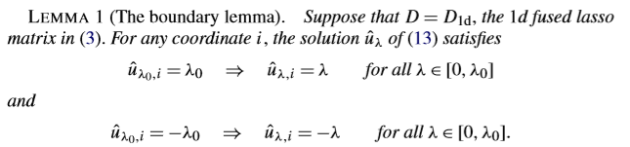



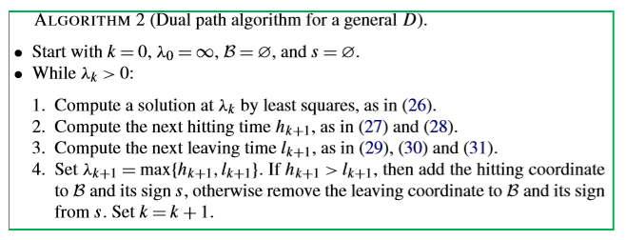

Tibshirani, Ryan J., and Jonathan Taylor. "The solution path of the generalized lasso." The Annals of Statistics 39.3 (2011): 1335-1371.
Main tool: primal --> dual in OR

Slide 3

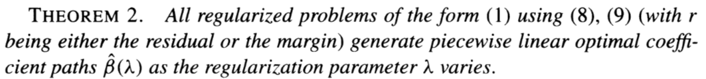

Rosset, Saharon, and Ji Zhu. "Piecewise linear regularized solution paths." The Annals of Statistics (2007): 1012-1030.
Contribution:
Main result:
Computational complexity:

Slide 4
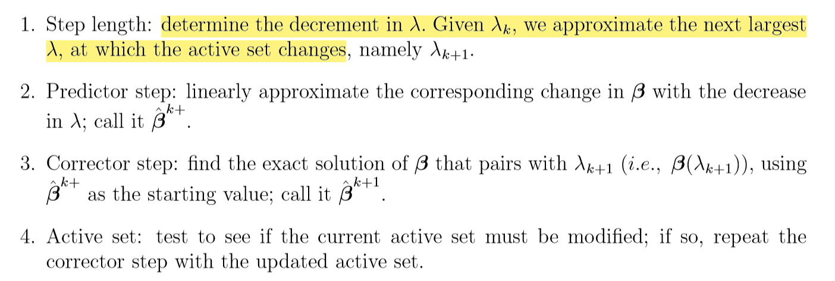




Park, Mee Young, and Trevor Hastie. "L1‐regularization path algorithm for generalized linear models." Journal of the Royal Statistical Society: Series B (Statistical Methodology) 69.4 (2007): 659-677.
Objective: generalized linear models
Main idea: We propose a way to compute the exact coeﬃcients at the values of λ at which the set of nonzero coeﬃcients changes

Slide 5

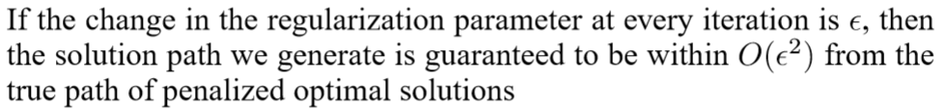
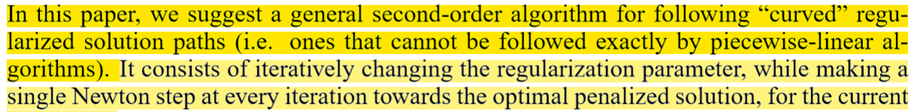
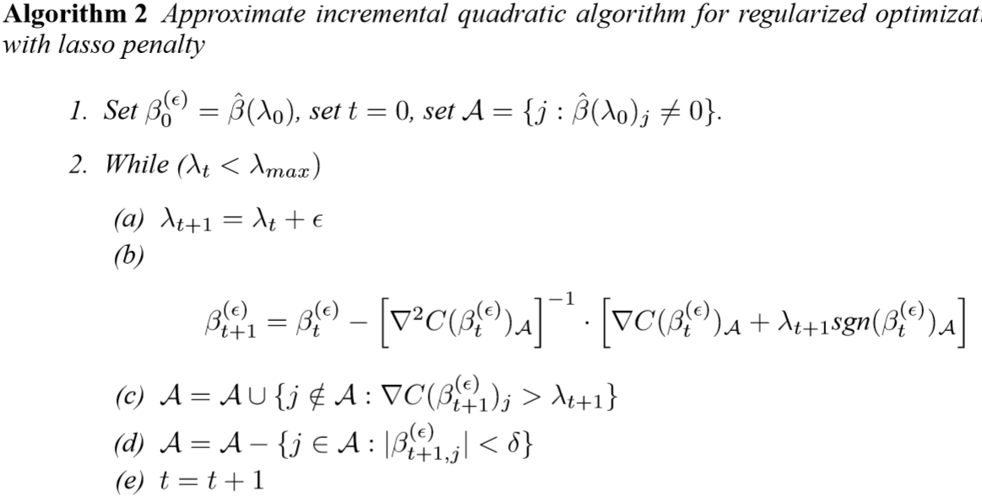
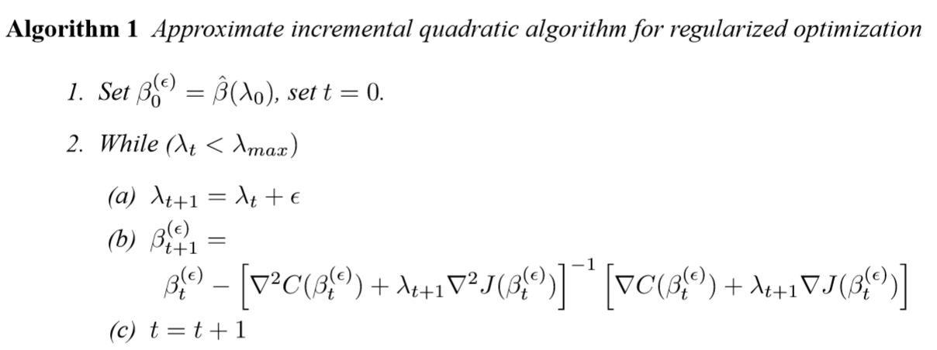
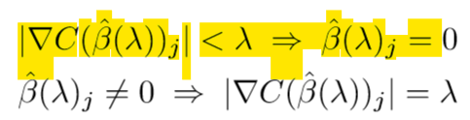


Rosset, Saharon. "Following curved regularized optimization solution paths." Advances in Neural Information Processing Systems. 2005.

Slide 6
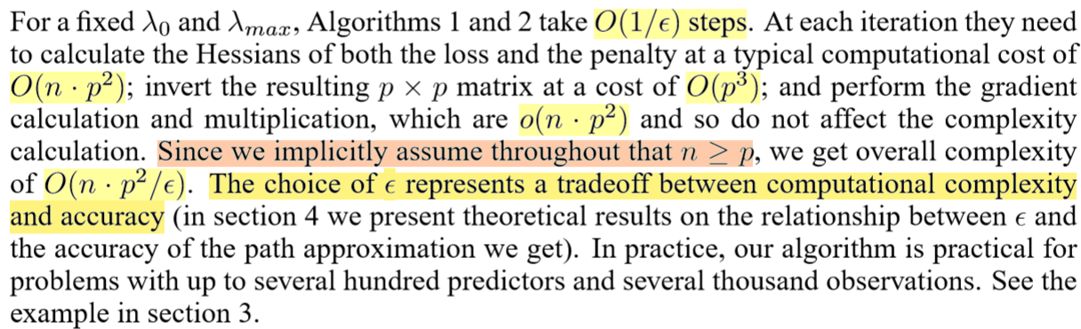
Rosset, Saharon. "Following curved regularized optimization solution paths." Advances in Neural Information Processing Systems. 2005.

Slide 7

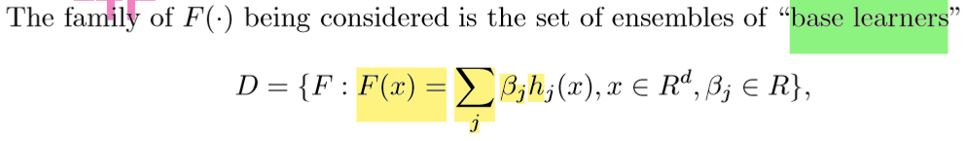
Zhao, Peng, and Bin Yu. Boosted lasso. No. UCB-STATS-678. CALIFORNIA UNIV BERKELEY DEPT OF STATISTICS, 2004.

Slide 8

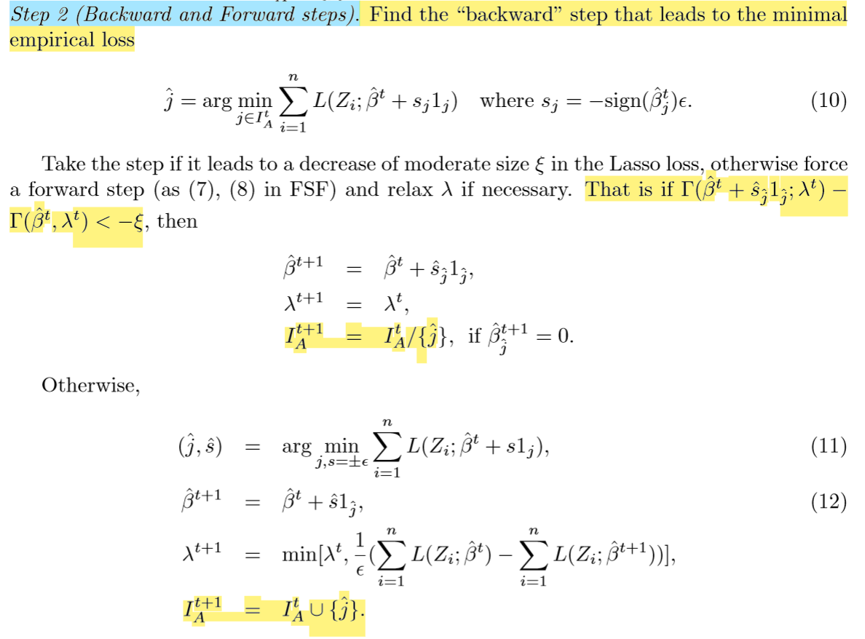
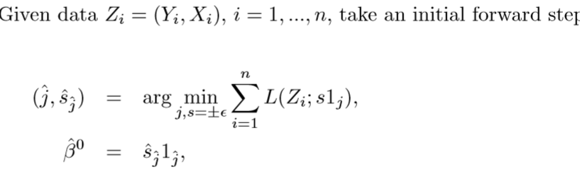
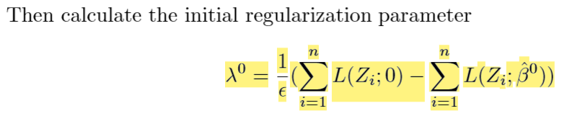
Zhao, Peng, and Bin Yu. Boosted lasso. No. UCB-STATS-678. CALIFORNIA UNIV BERKELEY DEPT OF STATISTICS, 2004.

Slide 9
Summary
LASSO
Tibshirani, Ryan J., and Jonathan Taylor, 2011
① Primal-dual
② Convex optimization
Exact
Generalized loss function and penalty
Rosset, Saharon, and Ji Zhu, 2007
Generalized linear regression
Park, Mee Young, and Trevor Hastie, 2007
Rosset 2005
① no-dual
② approxiamtion
Approximation of path following
Bin Yu 2004

